Slide 1
Generating and Collecting Sports Data
Saryu Onishi
HES 3000-002, Sport Performance Analytics
Notes:
Overview of the three domains (Tracking, Scouting, Strategy) and how data changes sports decisions.

Slide 2
Data Access
Difficulty
Public
General purpose
Aggregated
Proprietary
Specific purpose
Granular
Notes:
Data is generated through specific methods, with unique constraints
Data may be locked behind paywalls or within organizations

Slide 3
WHO
Collects sports data?

Slide 4


League/Competition Providers
Leagues may provide standardize data across all teams/matches
  Examples: NBA stats, FIFA match data
Pros:
  Standardized
  Easy to access
Cons:
  One-size-fits-all
  Slow to innovate
Notes:
Obviously, many sports leagues collect data.
Not only for business but also for performance! Eg: nextgen stats
This is how they control game data. data is distributed to teams
Consistency is a major benefit
Might not get what you need from the one size fits all approach

Slide 5


Teams (Internal data)
Teams often try to collect and analyze data to gain a competitive advantage
  Examples: Proprietary load monitoring, custom tactical metrics
Pros:
  Tailored to specific analytical needs
  May create competitive advantage
Cons:
  No external benchmarks
  Inaccessible to outsiders
Notes:
Because teams may have more specific needs, they collect their own data
Its all about the competitive adv
Great for the team
Difficult for anyone outside to use that

Slide 6
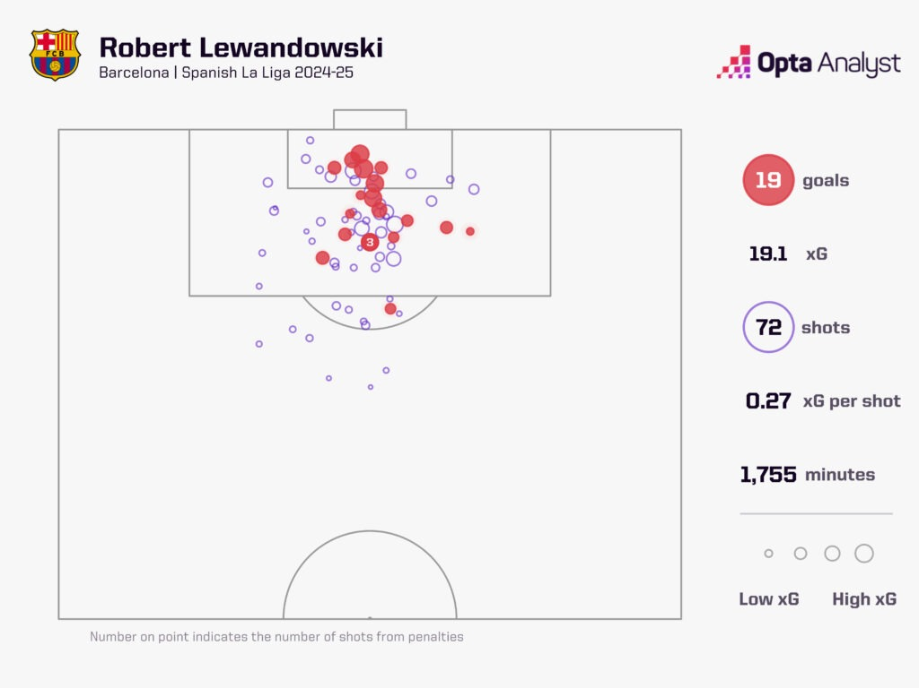
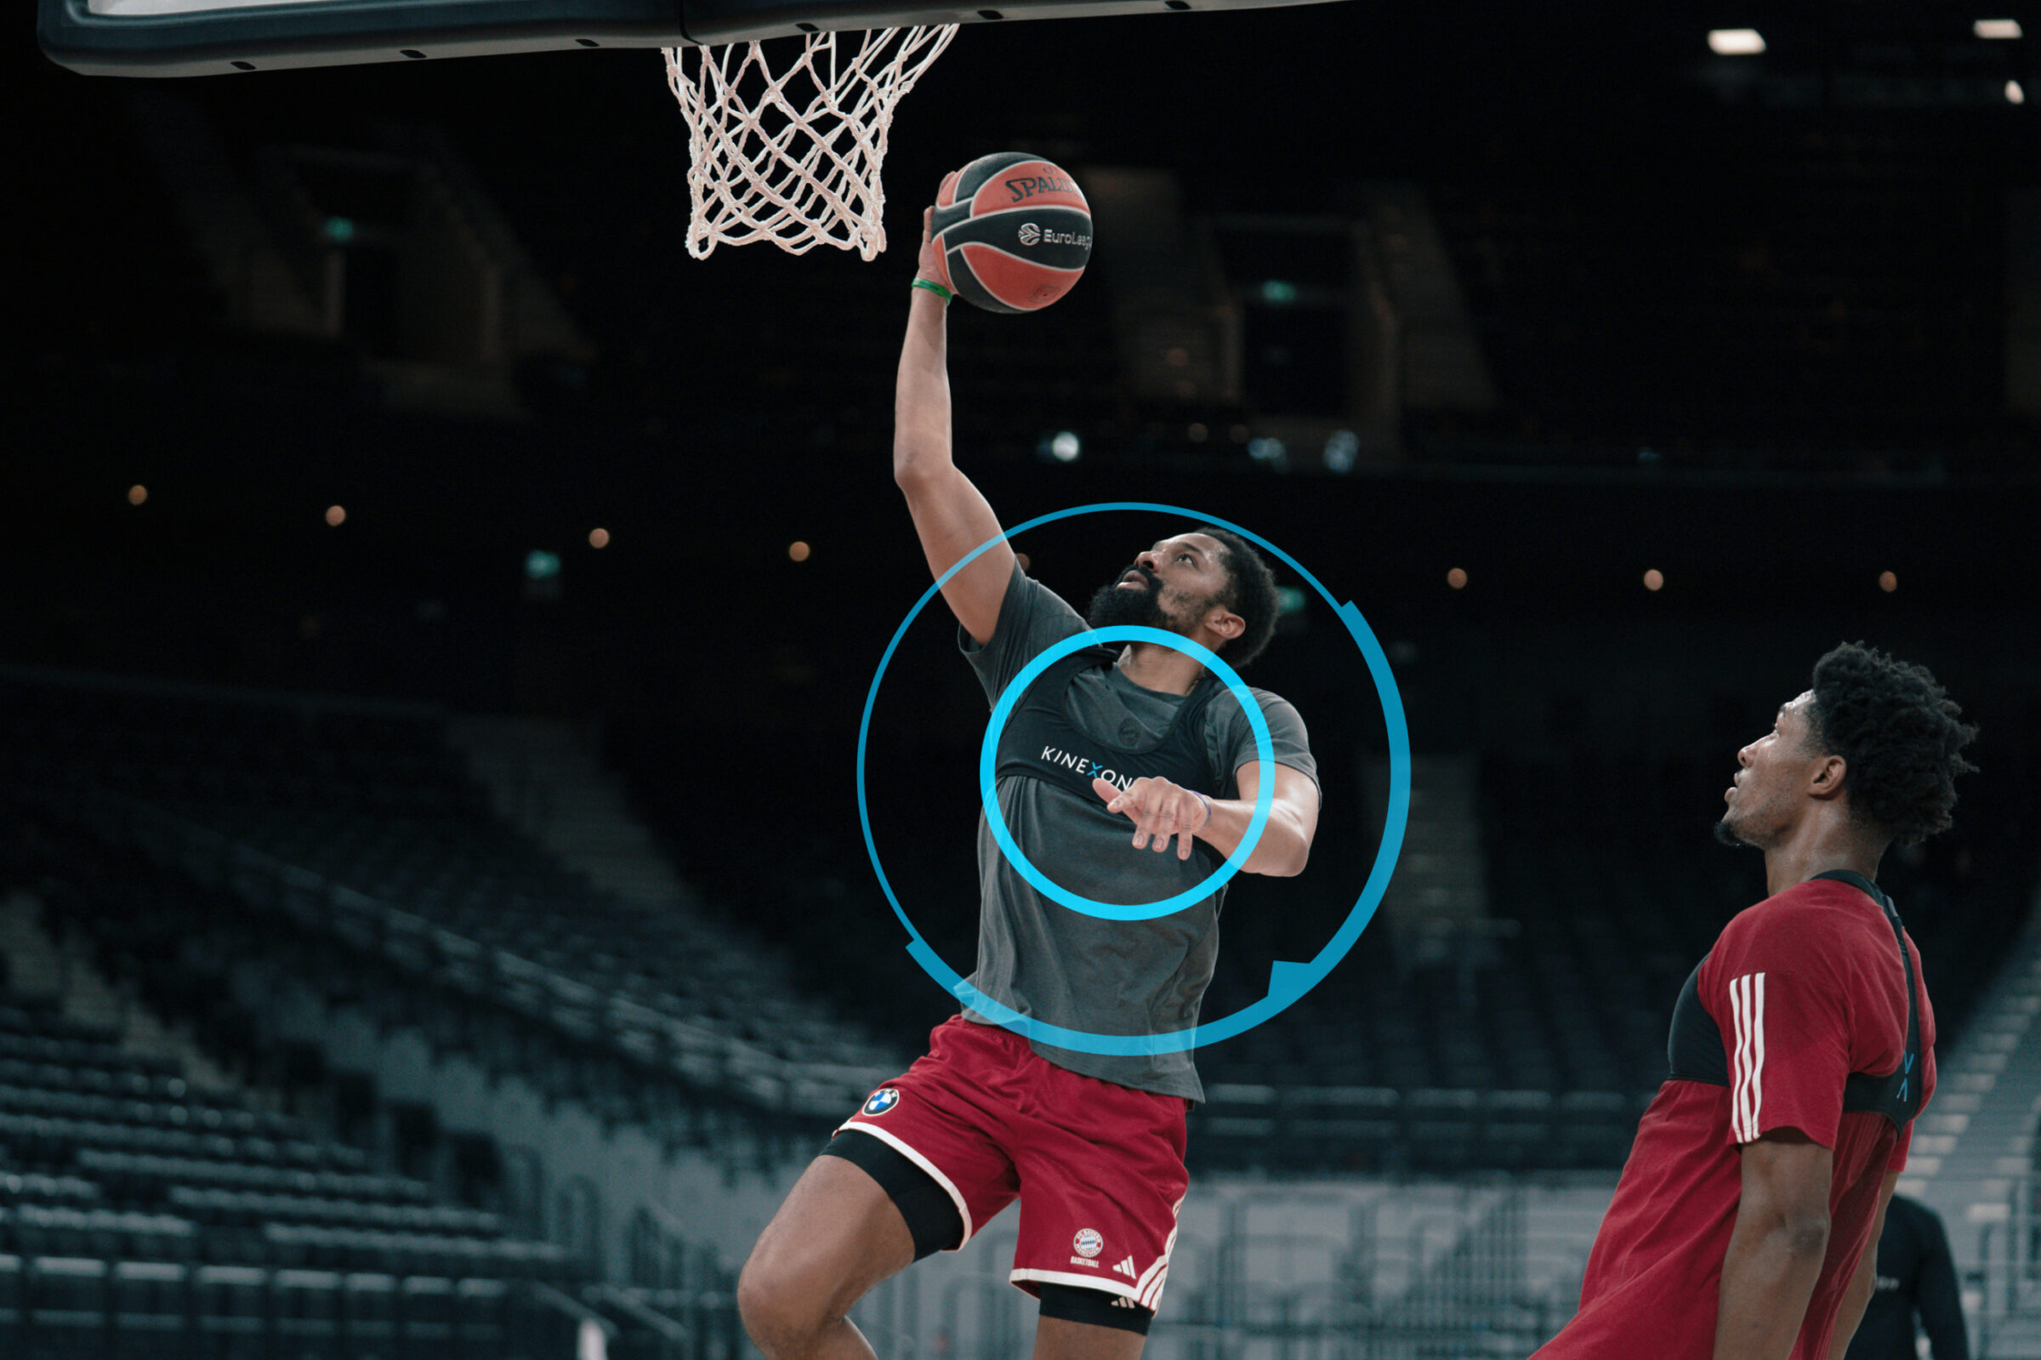
Third-Party Vendors
Some businesses sell data collection technology and data analysis software
  Opta, Stats Perform, Catapult, Kinexon, etc.
Pros:
  Expertise and scale
  Access (for a price)
Cons:
  Black box algorithms
  Vendor lock-in
  Minimal competitive advantage
Notes:
Many (leagues and teams) buy data from companies.
Its unreasobale to develop own tech to collect, or to do observational for everything
These data gets integrated into systems
This offloads responability and expertise
Offloading / outsourcing means giving up control and to some degree, competitive advantage

Slide 7
Academic/Research Institutions
Research institutions prioritize methodological rigor.
Pros:
  Reliable methods
  scientific collaboration
Cons:
  Limited samples
  specific contexts
  slow dissemination

Slide 8
How
is sports data collected?

Slide 9
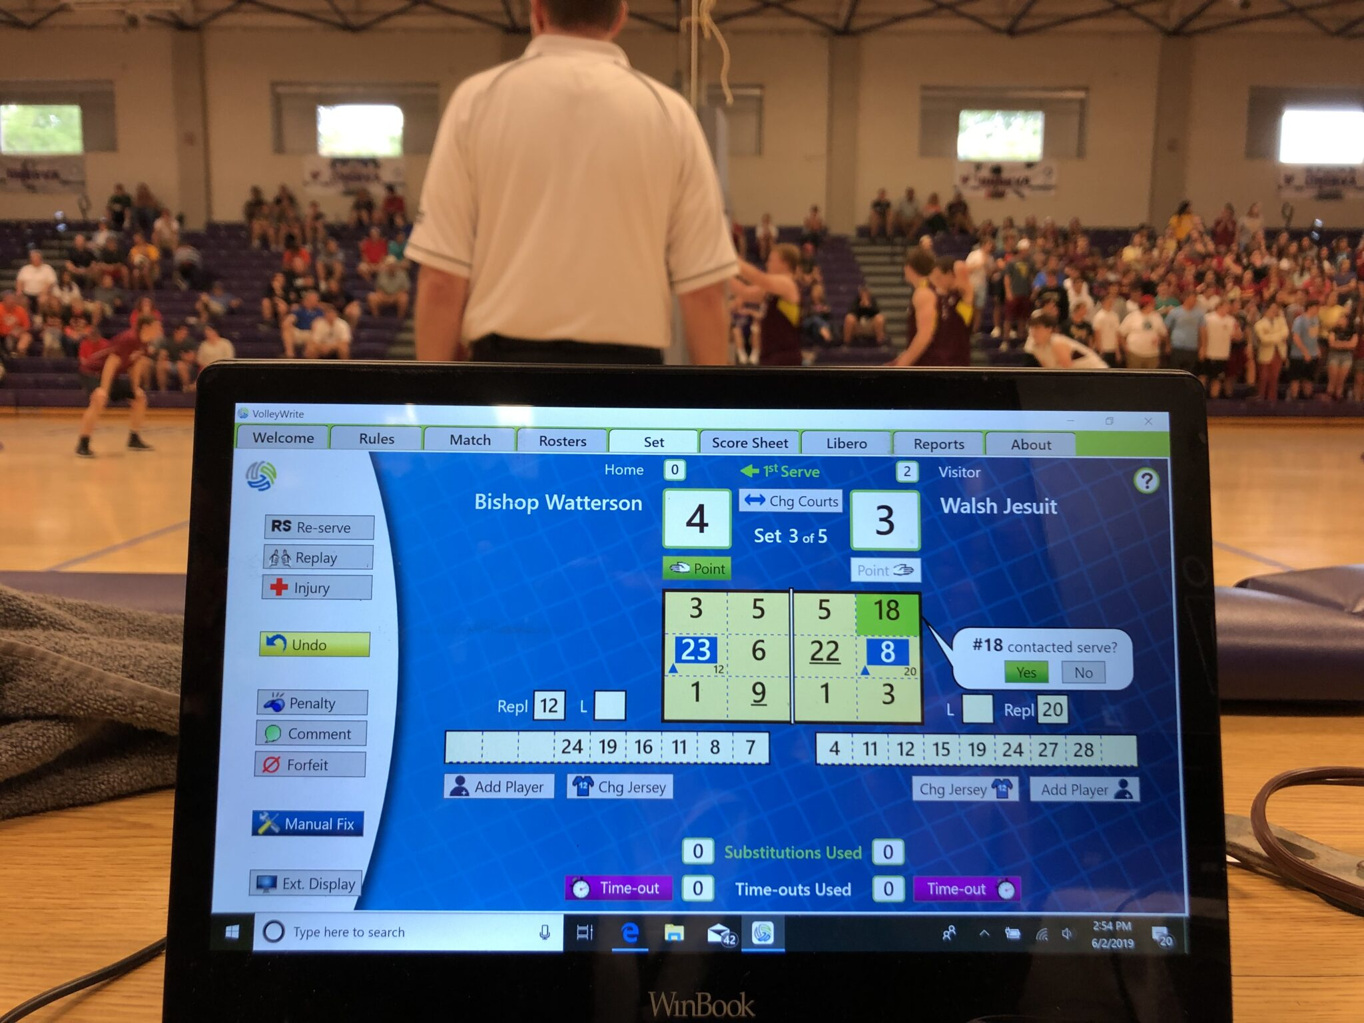
Observational
Scout with notebook, coach's tactical board, video coding
Strengths: Contextual, can capture nuanced behaviors
Limitations: Schema determines possibilities, subjective, time-intensive
Notes:
This is when observations are recorded.
This is MULTIMEDIA (reference). Raw = “FILM”, coded = stat sheet
Schema = rules, categories, framework. Eg: often tagging video means assigning specific action to an observation
Subjective = low interrater reliability

Slide 10
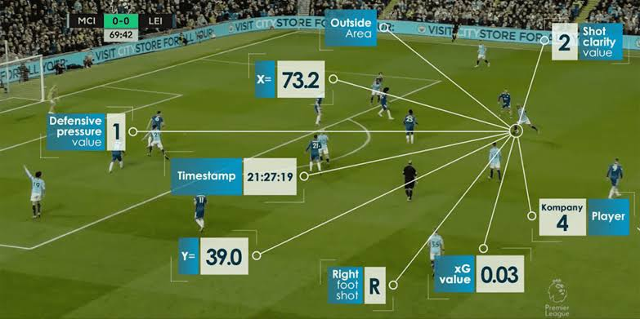
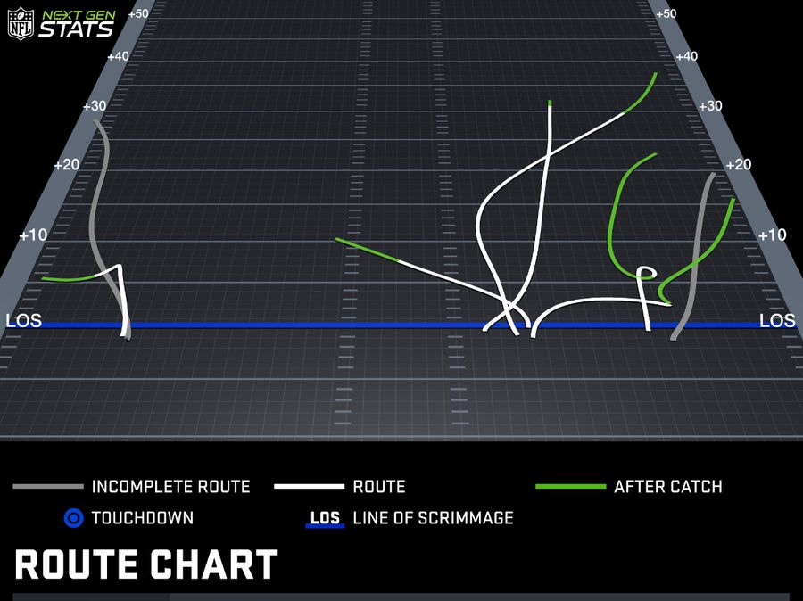
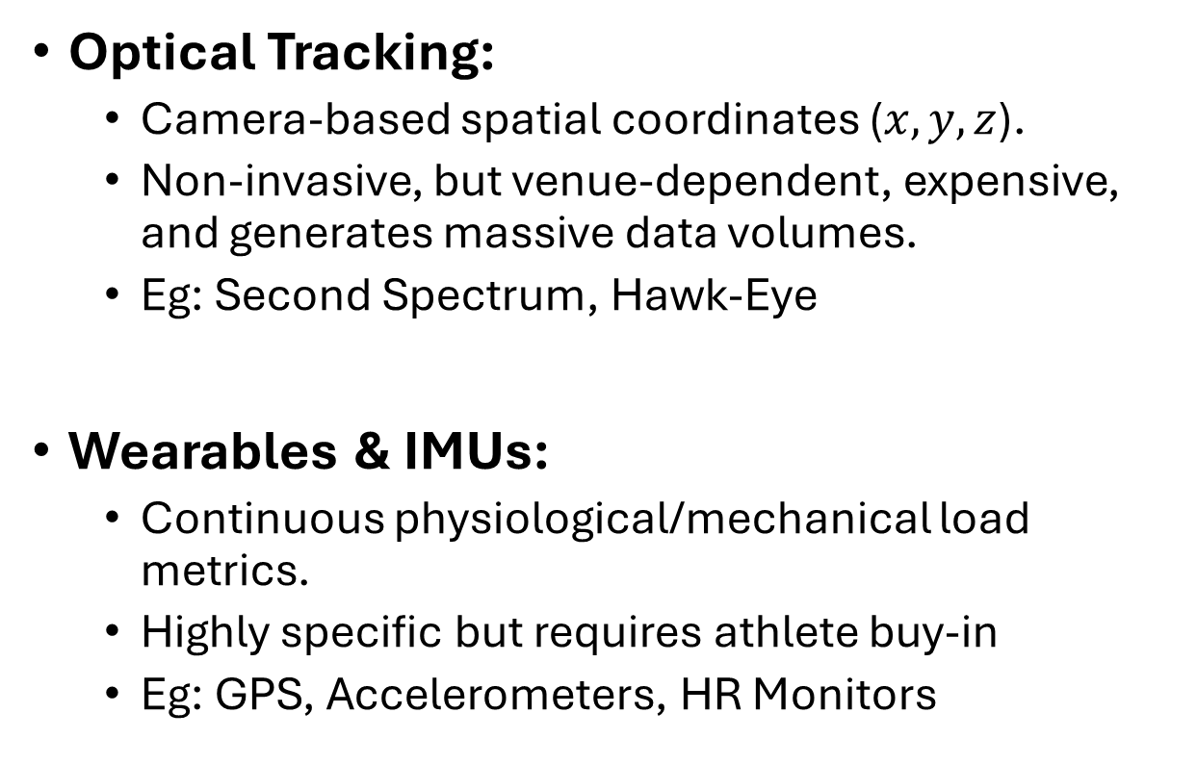
Commercial technologies
Optical Tracking:
  Camera-based spatial coordinates ($x,y,z$).
  Non-invasive, but venue-dependent, expensive, and generates massive data volumes.
  Eg: Second Spectrum, Hawk-Eye
Wearables & IMUs:
  Continuous physiological/mechanical load metrics.
  Highly specific but requires athlete buy-in
  Eg: GPS, Accelerometers, HR Monitors

Slide 11
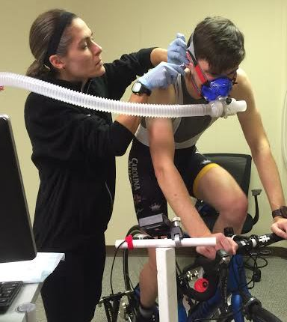
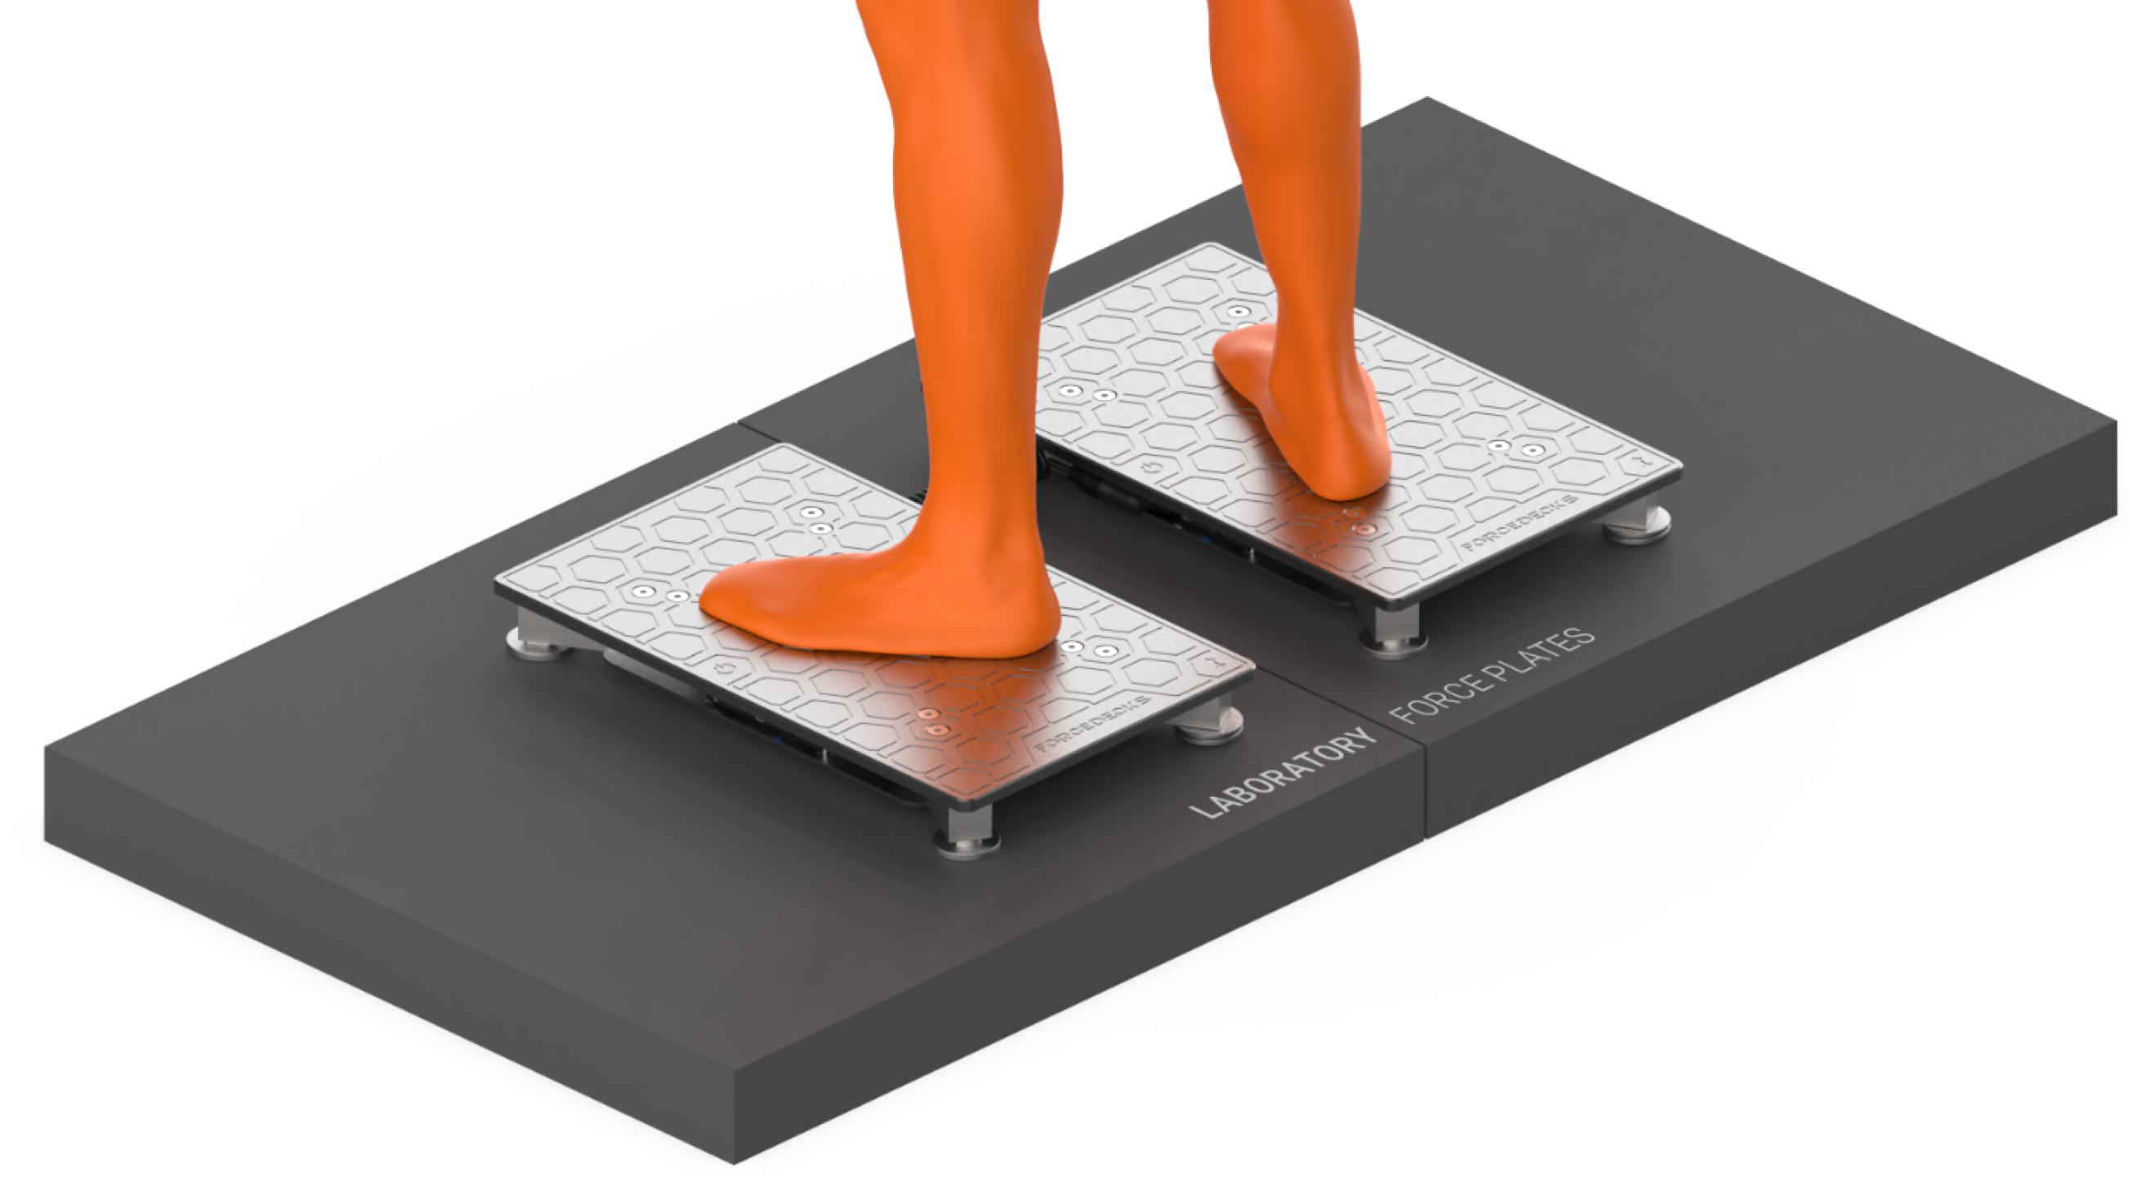
Laboratory Equipment
Force plates, motion capture, metabolic carts, isokinetic testing
Strengths: Gold-standard precision, controlled conditions
Limitations: Artificial environment, doesn't capture competition reality
Notes:
This is what we do in research.
Attempt to control all confounding factors to measure one thing.

Slide 12
Human vs Instrument
Human-recorded data
Examples:
  Scouting grades
  Notational analysis
  Coach observations
  Injury or participation records
  Event tagging
Instrument-generated data
Examples:
  GPS or local positioning systems
  Optical tracking
  Force plates
  Heart-rate monitors
  Timing systems
Notes:
Emphasize that people decide what counts, how categories are defined, and when an event is recorded.

Slide 13
Primary vs Secondary
Primary data
You collect data for a specific question
Pros: Full control over what and how data are collected
Cons: Time and resource intensive, access can be a challenge
Secondary data
Data collected by someone else for their specific question or general use case
Pros: does not require time and resources, or direct access to sport or athlete
Cons: may not fit your analytical question

Slide 14
What
Does this data represent?

Slide 15
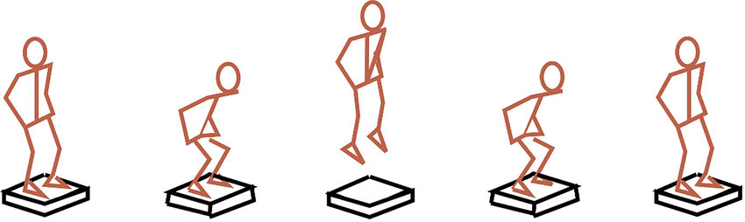
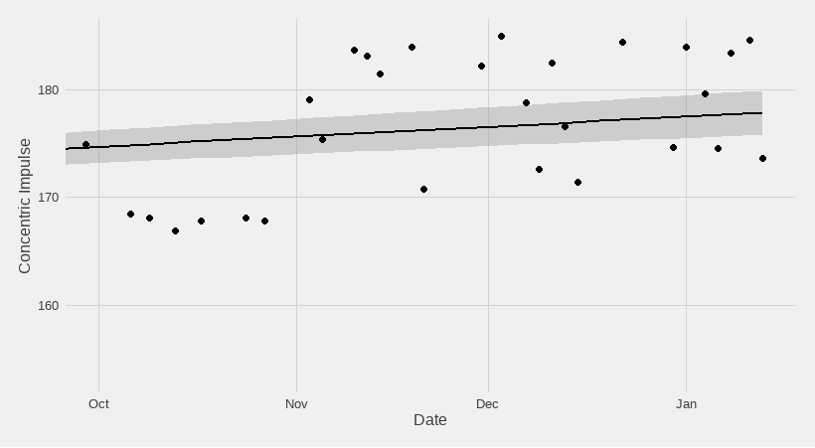

Event → Dataset Pipeline
event → data collection → data processing → analytics
Notes:
A player performs a jump → force plates record force → software identifies takeoff → an equation estimates jump height → one jump-height value appears in a table.

Slide 16
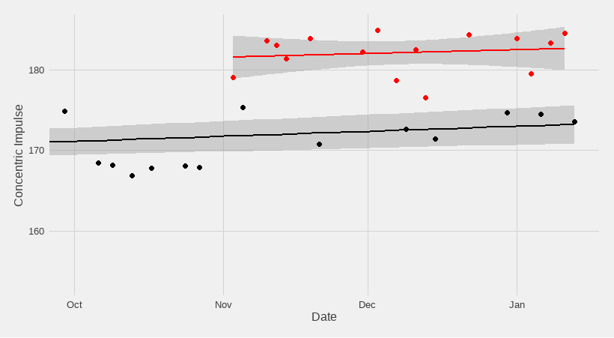
Context from the “what”
data
CMJ before practice and games

Slide 17
Direct / Raw Measurements
Unprocessed or minimally processed signals straight from the sensor, human observer, or box score.
Objective, transparent, but high-volume and often noisy.

Slide 18
Derived / Calculated Metrics
Variables created by applying formulas, algorithms, aggregations, or statistical models to raw data.
High interpretability but carries assumptions and choices made by whoever engineered the metric.
Notes:
MORE ERROR!

Slide 19
Dealing with incomplete data
Adjust scope of question
Be creative and find a proxy measure
  Eg: workload data is often inaccessible. However, schedule density, back-to-back flags, or minutes played can serve as proxies.

Slide 20
Summary & Looking Ahead
Know who collected the data, how the data was collected and what the data represents
Understand how these may affect your data collection and analysis
Next: data characteristcs

